Slide 1
Let’s talk javascript
When things become suddenly much less (and yet also much more) fun…

Slide 2
Today’s Schedule
Review!
The Importance of Pseudocode
Javascript Fundamentals
  First, why javascript?
  Second, what is it?
  Third, how do I use it??

Slide 3
Review time!

Slide 4
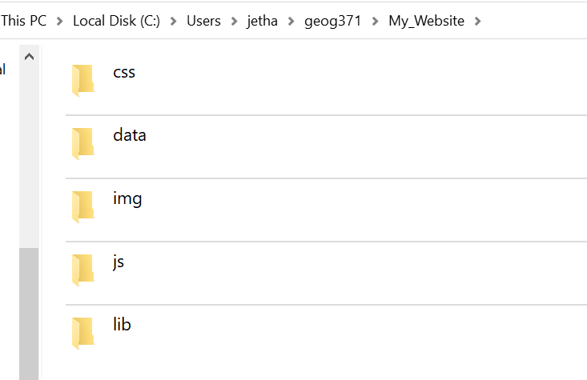
Some helpful terms
HTML - HypterText Markup Language
  Primary language for ‘the web’
  Invented by Tim Berners-Lee in 1989 in the particle physics CERN laboratory
  First graphical browser in 1992
CSS - Cascading Style Sheet
  Defines the appearance of a website
  Allows separation of content and presentation!
Javascript
  High-level language that runs in a web browser
  Dynamic typing, object oriented… multi paradigm support
Notes:
This is the key for us. We can talk more about the others, and you should read/learn about them as you encounter them. But, for web mapping…

Slide 5

HTML, CSS, and Javascript - a ‘cheat sheet’
Notes:
HTML defines the structure of the content. CSS defines the look of it. Javascript (or another language) allow for dynamic actions.

Slide 6
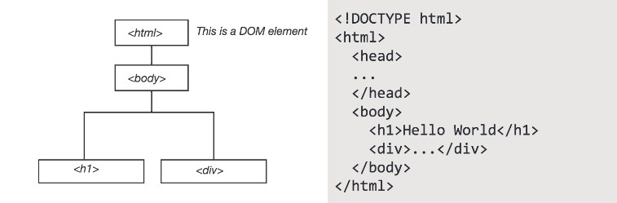
We reference objects through the DOM which allows for interactivity… and all web mapping… to take place

Slide 7
Cascading Stylesheets
Styling language used to describe look and formatting of html pages.
Uses the DOM to style elements, with styles ‘cascading’ from higher elements to lower ones (down the tree structure)
  Nested elements will be styled the same as higher elements… unless you specify otherwise.
Generic format is:
[selector]{
[property] : [value];
}

Slide 8
Pseudocode
Scripts are meant to accomplish something
  Update a file on click
  Load an image if they scroll here
You are very smart and an excellent communicator… your computer not so much.
Pseudocode helps us break apart big problems into smaller ones that are easier to convert into something a computer can understand.
Or why programming is kind of like cooking…

Slide 9
Pseudocode helps us think computationally
Start by writing down what you want your script to do.
Then, fill in each step you have to take to accomplish that goal.
It sounds simple, and can be, but it’s an important way to think through our goals.
Make a cup of tea
Gather ingredients
Boil water
Put teabag in cup
Add boiling water to cup
Wait
Remove teabag
Add milk and sugar
Serve

Slide 10
Pseudocode helps us think computationally
Start by writing down what you want your script to do.
Then, fill in each step you have to take to accomplish that goal.
It sounds simple, and can be, but it’s an important way to think through our goals.
Make a cup of tea
Gather ingredients
  Tea bag
  Cup
  Water
  Kettle
…. And so on… break it apart!

Slide 11
When stuck, try to write it out in pseudocode.

Slide 12
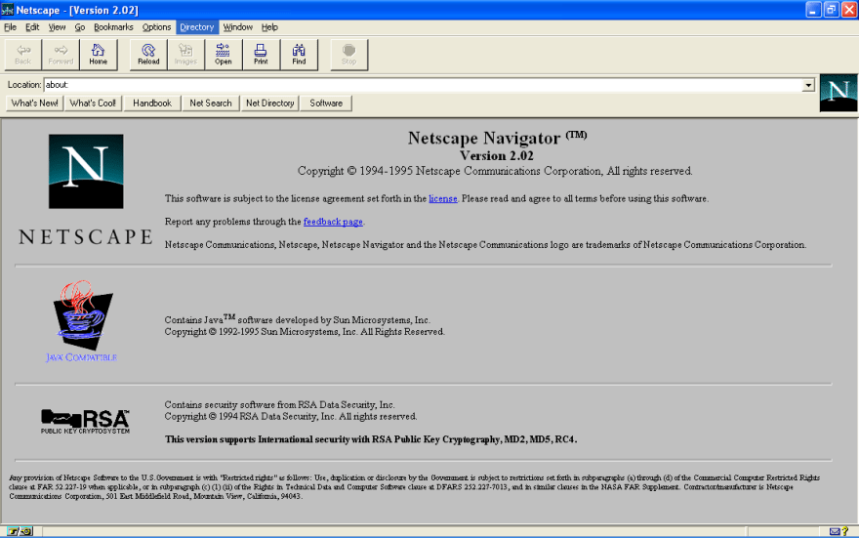
But why javascript?
First graphical web browser, Mosaic, in 1993, but websites are static.
1994 sees Netscape Navigator release
1995 - Netscape partners with Sun Microsystems to embed Java in their browser while also hiring Brendan Eich to embed Scheme
Very quickly realize a new language was needed

Slide 13
Javascript… not java…
Goal was for something lightweight and easy to grasp - for scripters, not programmers
  Java seen as too heavy, too ‘enterprise’ like
  Idea was originally a scripting companion to java (java for programs, javascript for web pages, etc.)
First called Mocha, then LiveScript, and eventually Javascript
  Allegedly developed in ten days
BUT IT’S NOT REALLY AT ALL LIKE JAVA
Notes:
This is where people often get confused. It kind of looks like java in some of its syntax. It shares a name with java. It even has a development history that’s tied to it…
But it’s really far more a lovechild of scheme and some other systems than it is something like java.

Slide 14

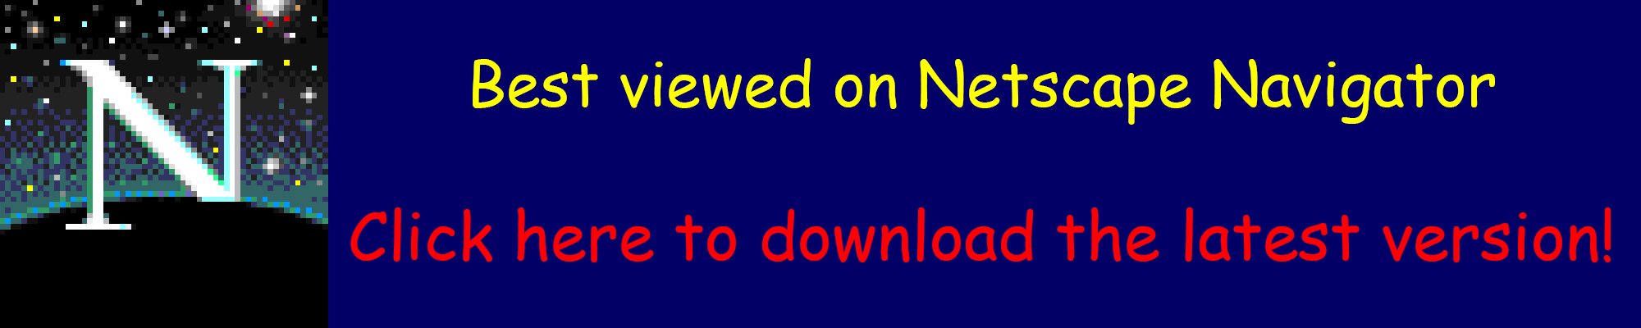
ECMAscipt vs. JScript vs…
“Browser Wars”
  Basically, each browser had its own specific scripting elements. They were similar but not the same.
  This was a nightmare and really stagnated web development for a few years
Google debuts Chrome with V8 Javascript engine in 2008
  Just-In-Time compilation makes it faster…
Finally, in 2009 they all agree to work together with ECMA standards
Notes:
ECMA was the European Computer Manufacturers Association, but has been renamed just Ecma International. It develops standards.

Slide 15
Allows for dynamic interactions on the web.
All modern browsers have dedicated engines to execute it.
Notes:
It’s CLIENT SIDE. which is what’s so important.
And that’s why we learn it.

Slide 16
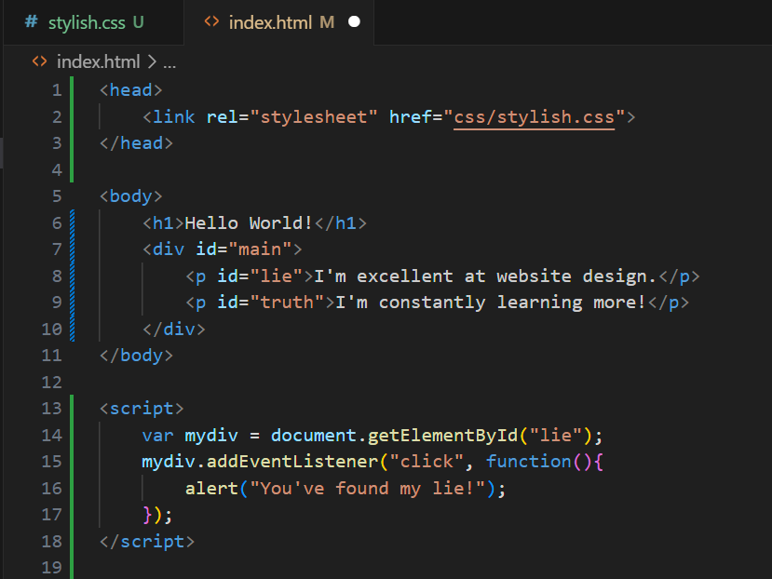
It can be quite simple…
Much like with CSS, we can have our scripts written into our main pages
But, it’s better practice to keep them separated.
You can use this technique to dynamically generate content…
Notes:
Let’s walk through this script…

Slide 17
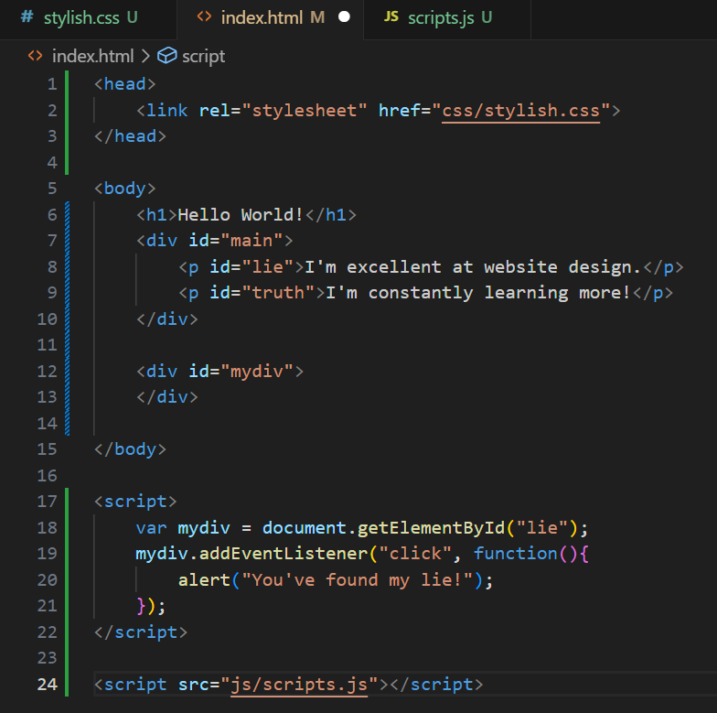
‘Dynamic’ Text
This is a bit canned, but let’s see how you can use javascript to manipulate the DOM and ‘create’ a web page.
In your /js/ directory, create a file called [whatever].js (I called mine scripts.js)
Now, let’s load and inspect it…
Notice I’m doing something very sloppy here, what is it?

Slide 18
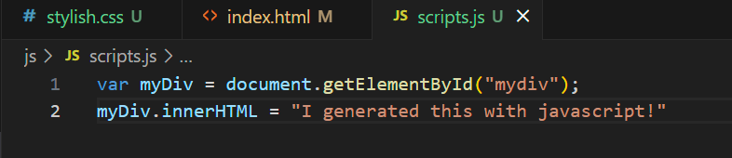
‘Dynamic’ Text

Slide 19
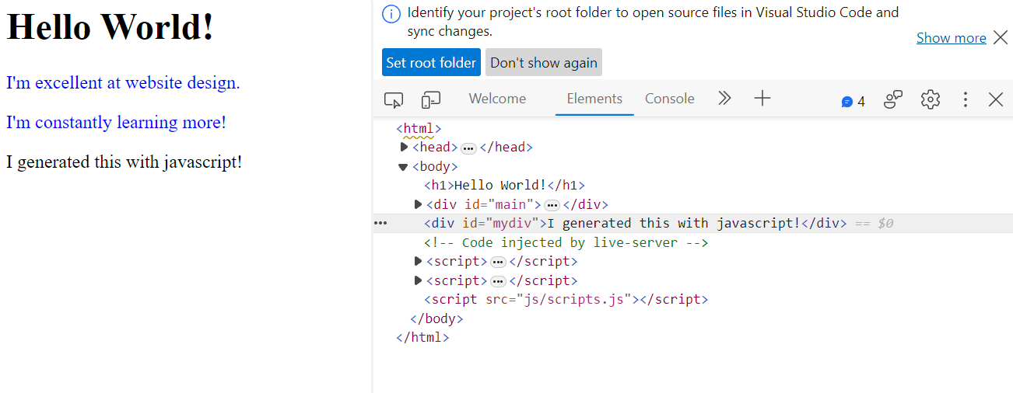

Slide 20
Where you should be… (by like next week)
Gaining comfortability with git and github
Have an understanding of what CSS, Javascript, and HTML are and how they fit together
Beginning to gain experience using CSS to style web sites and Javascript to make them dynamic
Next Two Weeks:
A ‘deep’ dive into the basics of javascript
And then… actual web mapping.

